Slide 1

Department of Computer Applications
SEMESTER END EXAMINATIONS,MAY 2025 MCA-Specialization, 4th SEMESTER
Project Title
Student Name:
RegisterNumber:
Internal Guide:
External Guide:

Slide 2
Problem Statement

Slide 3
Introduction

Slide 4
Importance of the project

Slide 5
Objectives

Slide 6
Why This Project Matters

Slide 7
Challenges Being Addressed

Slide 8
Related Work
Prior Work | What They Did | Limitations They Mentioned | My Contribution

Slide 9
Methods & Technologies

Slide 10
Step-wise Development Process
.
4/25/2026
11

Slide 11
Configuration Used

Slide 12
Analyses & Data Representations

Slide 13
Results
Metric | Description

Slide 14
Output Visuals
Metric | Description

Slide 15
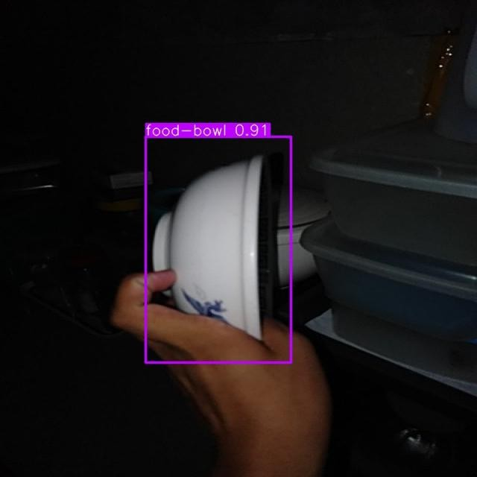
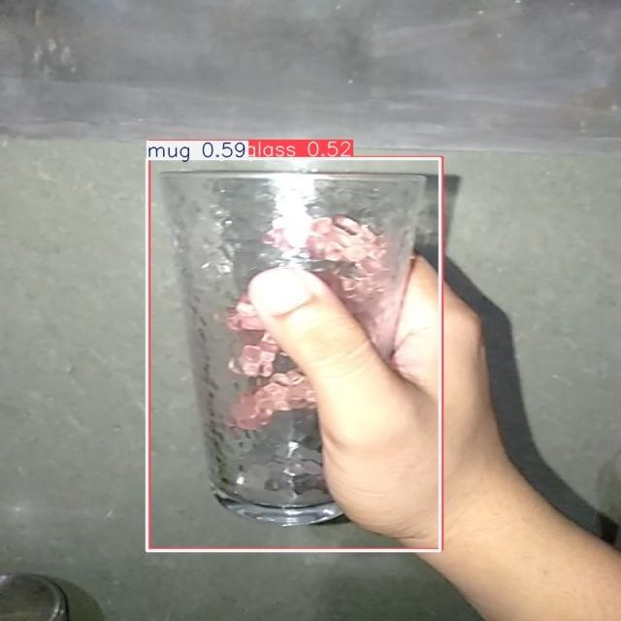
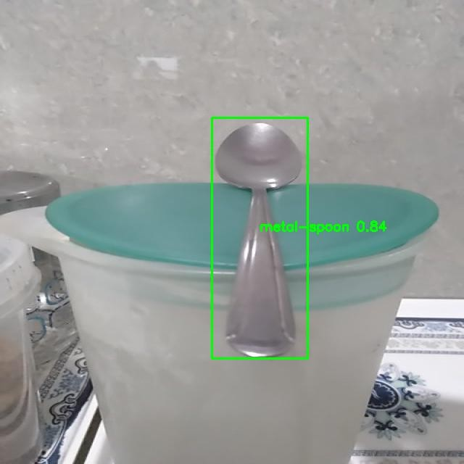
Output Visuals
4/25/2026
18

Slide 16
Conclusion
25-04-2026
19

Slide 17
Objective | How It Was Achieved
Detect kitchen objects in real-time
Assist elderly users
Robust model performance
Work in challenging conditions
How Objectives Were Met
20

Slide 18
Limitations & Possible Improvements
Current Limitations
Possible Future Improvements

Slide 19
Research scope

Slide 20
References

Slide 21
Acknowledgements

Slide 22
Q&A

Slide 23
Thank You

